Slide 1






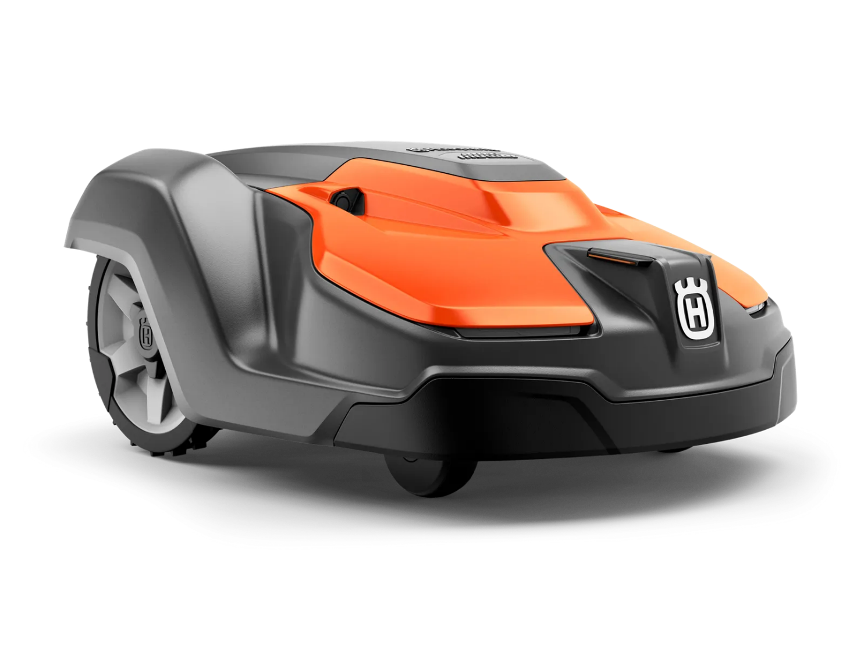
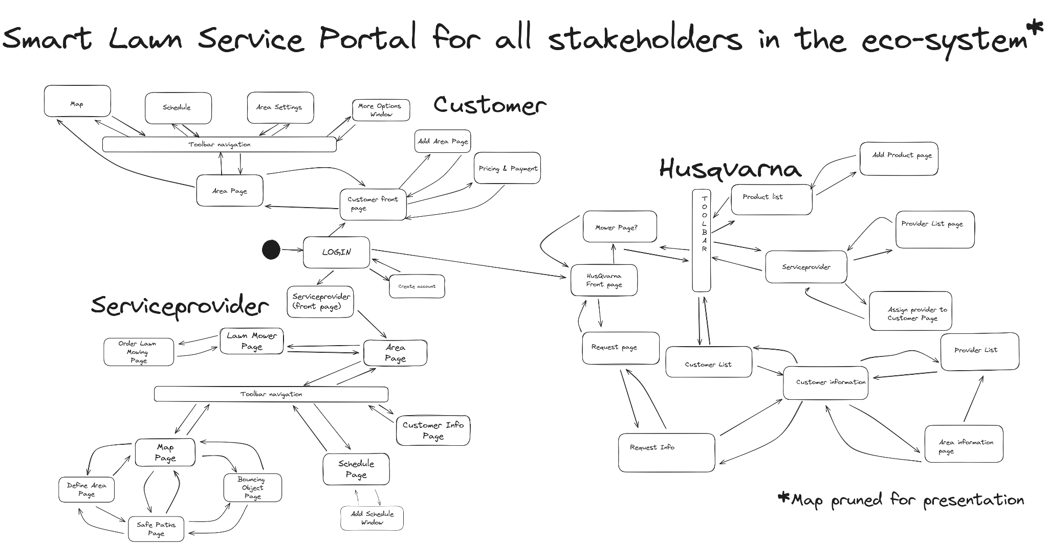
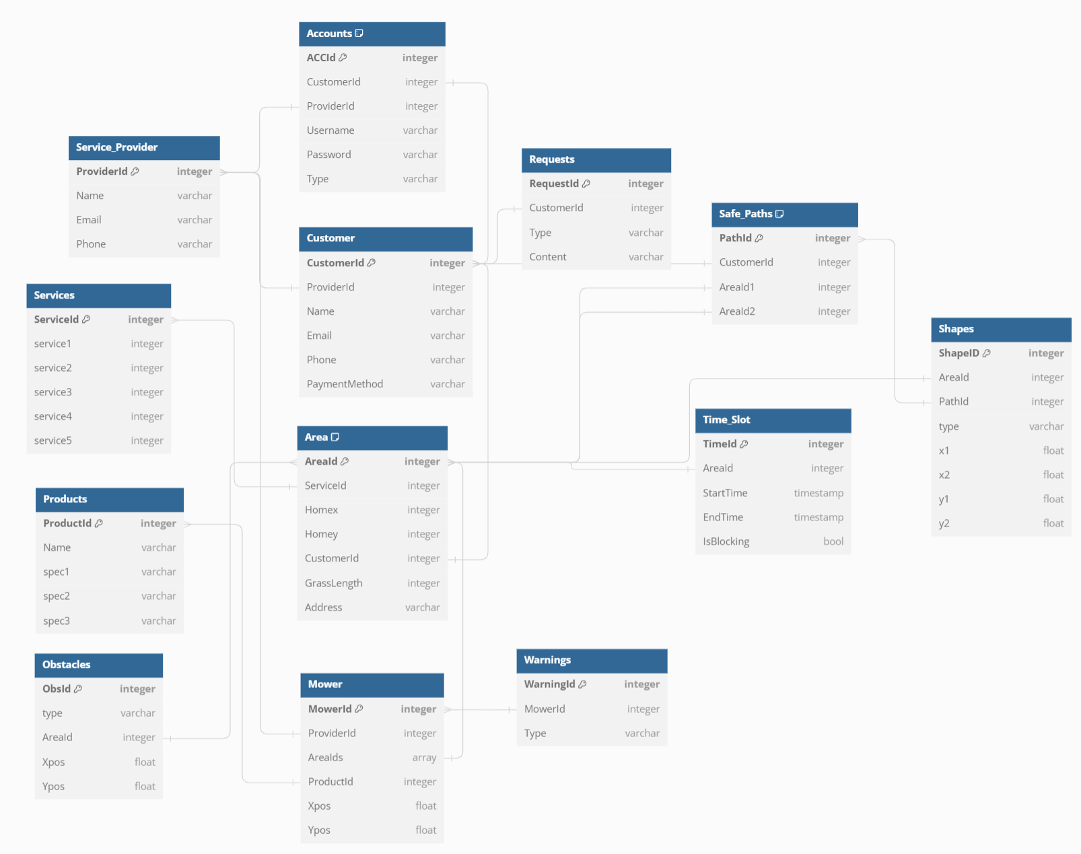


www.aims50.eu
Smart Lawn Service Portal (use case 3)
The “as a service” type of business model brings the promise of better customer satisfaction and lower efforts related to not owning a product and instead focusing on fulfilling actual needs. Other benefits may include improved sustainability in terms of more accurate resource usage through flexibility and adaptation of service according to evolving needs. Unfortunately, the administrative overhead associated with “as a service” offerings tend to be extensive due the lack of digital tools and automation apt for this business. A web-portal at which the needed administration can be done by the different stakeholders in the eco-systems is being developed as a first step to minimize the administrative overhead. Later steps involve investigating the use of smart contracts for Service Level Agreements (SLAs), digital twins, and workflow automation to further reduce this overhead.
Data model
The data model for the Smart Lawn Service Portal is designed to support the envisioned interactions between the stakeholders in the eco-system. In particular, the following aspects are considered:
Workflow management and coordination of planned and unplanned services
Customer self-management of the service, e.g., on lawnmower schedule connected to individual areas like soccer fields sometimes more intensively used
Flexible service-level agreements that can be adapted/changed by the customer, e.g., to request the grass to be cut shorter
Multiple-step issue handling, e.g., allowing the customer to fix simple problems before invoking services
Easy assignment of lawnmowers and service providers to customers
... and more to be investigated …
By
Project group: Nils Borg, Markus Hyllengren, Jakob Kieri, Rasmus Svedberg
Supervisors: Olov Schelén and Ulf Bodin, LTU
Partners: Husqvarna, SEB, StreamAnalyze
Contact: olov.schelen@ltu.se, ulf.bodin@ltu.se
www.aims50.eu

